Slide 1
System Analysis
Chapter – 4
(BIT)

Slide 2
Topic Covered
4.1 System planning and initial investigation
4.2 Project management & scheduling
4.3 Requirement analysis
4.4 Types of requirements
4.5 Requirement gathering methods
4.6 Feasibility study and its types
4.7 Steps of feasibility study
4.8 Cost/benefits analysis (payback method, NPV method)

Slide 3
System Planning
&
Initial Investigation

Slide 4
What is planning
Planning is the process of setting goals, developing strategies and outlining task and program to accomplish the goal.
Developing a view of the future that guides decision making today
An orderly means of assessing the information needs of an organization and defining the systems, databases and technologies that will best satisfy those needs

Slide 5
Planning Difficulties
Business goals and systems plans need to align rapidly changing technology
Technological advances, obsolete technology
Continuous planning/monitor and follow change
Companies need portfolios rather than projects
Infrastructure development is difficult to fund
Responsibility needs to be joint
CIO, CEO, CFO, COO input is needed
Systems planning in becoming business planning.

Slide 6
Why planning?
Information is very important recourse for any company to be managed and it is equally important as the cash, personnel etc.
Financial resources are committed to the information system.
To make the system growing and retain in the competitive environment.

Slide 7
Planning Approaches
Top-down Planning
A generic information system planning methodology that attempts to gain a broad understanding of the information systems of the entire organization
Bottom-up Planning
A generic information systems planning methodology that identifies and define ID development projects based upon solving operational business problem or taking advantage of some business opportunities.

Slide 8
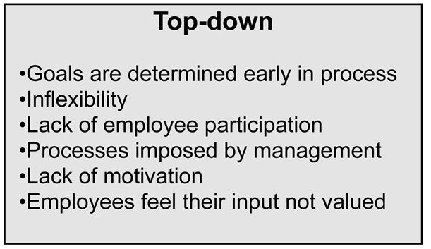
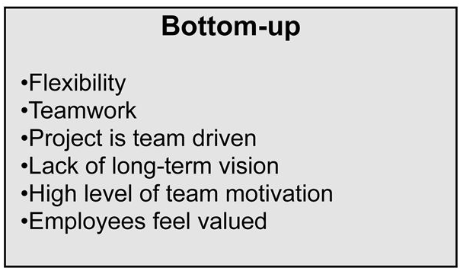
Top-down planning vs Bottom-up Planning

Slide 9
Initial Investigation
This is the first phase of SDLC and is known as identification of need.
This is a user’s request to change, improve or enhance an existing system.
The objective is to determine whether the request is valid or feasible.
The user request identifies the need for change and authorizes the initial investigation.

Slide 10
Strategies for determining information requirements
Asking
Getting information from present system
Prototyping.

Slide 11
Steps of Initial Investigation
Problem definition
Problem definition is the process of identifying the need of the user which led him to request for the system change.
Background analysis
- Background analysis is the process of getting the basic information about the customer‟s company or organization i.e. How it really works? What people are involved in it? Etc. Background analysis helps the system analyst to prepare the organization chart with the list of people and functions.

Slide 12
Steps of Initial Investigation (2)
Fact finding
After obtaining the background information, analyst start gathering the data like input, output and cost of the existing system. Information can be gathered by following tools:- a.) Review of written documents. b.) On-site observations c.) Interview and questionnaires
Fact Analysis
After the collection of data it must be organized and evaluated so that report can be prepared for the final approval from the user.
Determination of Feasibility
After organizing data, and fact analysis feasibility is evaluated and determine that any alternative proposal is possible or not for the customer‟s Project.

Slide 13
Information Gathering
Information gathering is an art and science of gathering information regarding present system so that designing a new system will be easy as well as free from errors and upto the customer requirement.
Sources: (internal)
Financial reports
Personal staff.
Professional staff, EDP
System documentaion or manuals
The user or user staff.
Reports and transaction documents.

Slide 14
Information Gathering
Sources(external)
Vendors
Government documents.
Newspapers and professional journals

Slide 15
Project Management
&
Scheduling

Slide 16
Introduction
Project management is the practice of initiating, planning, executing, and closing the work of a team to achieve specific goals and meet specific success criteria at the specified time.
A project is a temporary endeavor designed to produce a unique product, service or result with a defined beginning and end (usually time-constrained, and often constrained by funding or staffing) undertaken to meet unique goals and objectives, typically to bring about beneficial change or added value.

Slide 17
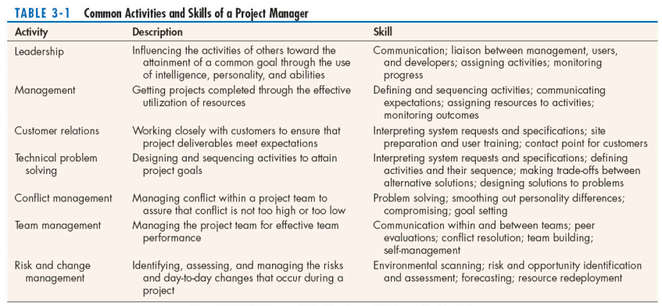
Activities & Skills of Project Manager

Slide 18
Phases of Project Management
Four Phases
Initiation the project
Planning the project
Executing the project
Closing the project

Slide 19
Initiating a Project
Project Manager performs several activities that access the size, scope and complexity of the project and establishes procedures to support subsequent activities.
Establishing the project initiation team
Establishing a relationship with the customer
Establishing the project initiation plan
Establishing management procedure
Establishing the project management environment and project workbook

Slide 20
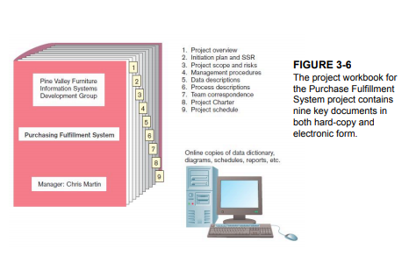
Project Workbook

Slide 21
Planning the Project
Define clear, discrete activities and the work needed to complete each activity
Tasks
Define project scope, alternatives, feasibility
Divide project into tasks
Estimate resource requirements
Develop preliminary schedule
Develop communication plan
Determine standards and procedures
Identify and assess risk
Create preliminary budget
Develop a statement of work
Set baseline project plan (schedule baseline, cost baseline and scope baseline.)

Slide 22
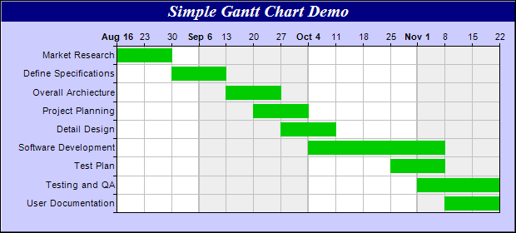
Simple Grantt Chart

Slide 23
Executing the Project
Plans created in prior phases are put into action.
Actions
Execute baseline project plan
Monitor progress against baseline plan
Manage changes in baseline plan
Maintain project workbook
Communicate project status

Slide 24
Closing down the project
Bring the project to an end
Actions
Close down the project.
Conduct post-project reviews.
Close the customer contract.

Slide 25
Requirement Analysis
&
Gathering Method

Slide 26
Requirement Analysis
Process of determining user expectations for a new or modified product
Requirement must be quantifiable, relevant and detailed.
The goal of requirement analysis is to clearly understand the customer requirements and to systematically organize the requirement into specification document

Slide 27
Requirements Gathering
AKA requirements elicitation
The analyst starts requirements gathering activity be collecting all information that could be useful to develop the system
Requirements elicitation practices include interviews, questionnaires, user observation, workshops, brainstorming, use cases, role playing and prototyping.

Slide 28
The Process of Determining Requirements
Good Systems Analyst Characteristics:
Impertinence—question everything
Impartiality—consider all issues to find the best organizational solution
Relaxing constraints—assume anything is possible
Attention to details—every fact must fit
Reframing—challenge yourself to new ways

Slide 29
Deliverables and Outcomes
Deliverables for Requirements Determination:
From interviews and observations — interview transcripts, observation notes, meeting minutes
From existing written documents — mission and strategy statements, business forms, procedure manuals, job descriptions, training manuals, system documentation, flowcharts

Slide 30
Deliverables and Outcomes (Cont.)
From computerized sources — Joint Application Design session results, CASE repositories, reports from existing systems, displays and reports from system prototype

Slide 31
Methods for Determining System Requirements
Traditional Methods
Contemporary Methods
Radical Methods
Agile Methodologies

Slide 32
1- Traditional Methods for Determining Requirements
Interviewing
individuals
groups
Observing workers
Studying business documents

Slide 33
1.1- Interviewing and Listening
One of the primary ways analysts gather information about an information systems project
Interview Guide is a document for developing, planning and conducting an interview.

Slide 34
Guidelines for Effective Interviewing
Plan the interview.
Prepare interviewee: appointment, priming questions.
Prepare agenda, checklist, questions.
Listen carefully and take notes (tape record if permitted).
Review notes within 48 hours.
Be neutral.
Seek diverse views.

Slide 35
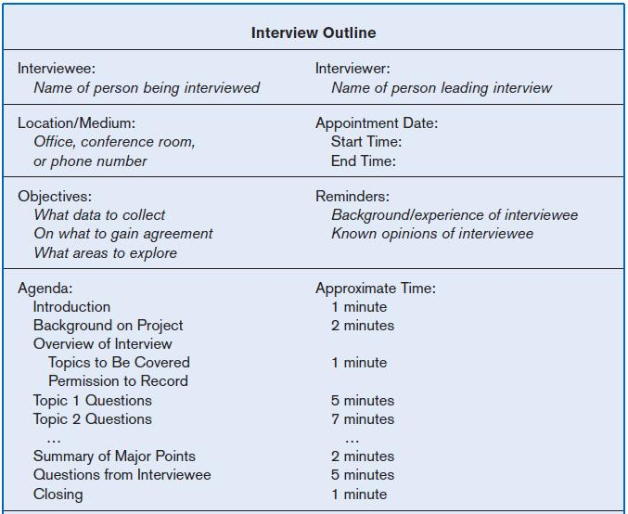
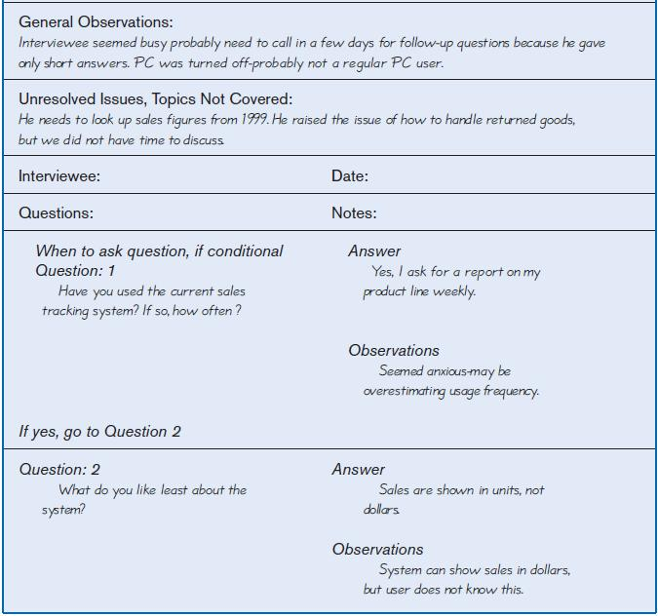
Interviewing and Listening (Cont.)
FIGURE 6-2 Typical interview guide

Slide 36
Choosing Interview Questions
Each question in an interview guide can include both verbal and non-verbal information.
Open-ended questions: questions that have no pre-specified answers
Closed-ended questions: questions that ask those responding to choose from among a set of specified responses

Slide 37
1.2- Interviewing Groups
Drawbacks to individual interviews:
Contradictions and inconsistencies between interviewees
Follow-up discussions are time consuming
New interviews may reveal new questions that require additional interviews with those interviewed earlier

Slide 38
Interviewing Groups (Cont.)
Interviewing several key people together
Advantages
More effective use of time
Can hear agreements and disagreements at once
Opportunity for synergies
Disadvantages
More difficult to schedule than individual interviews

Slide 39
Nominal Group Technique (NGT)
A facilitated process that supports idea generation by groups
Process
Members come together as a group, but initially work separately.
Each person writes ideas.
Facilitator reads ideas out loud, and they are written on a blackboard or flipchart.

Slide 40
Nominal Group Technique (NGT)
Group openly discusses the ideas for clarification.
Ideas are prioritized, combined, selected, reduced.
NGT exercise used to complement group meetings or as part of JAD effort. (Joint Application Design)

Slide 41
1.3- Directly Observing Users
Direct Observation
Watching users do their jobs
Obtaining objective measures of employee interaction with information systems
Can cause people to change their normal operating behavior
Time-consuming and limited time to observe

Slide 42
1.4- Analyzing Procedures and Other Documents
Document Analysis
Review of existing business documents
Can give a historical and “formal” view of system requirements
Types of Documents
Written work procedure
Business form
Report
Description of current information system

Slide 43
Analyzing Procedures and Other Documents (Cont.)
Types of information to be discovered:
Problems with existing system
Opportunity to meet new need
Organizational direction
Names of key individuals
Values of organization
Special information processing circumstances
Reasons for current system design
Rules for processing data

Slide 44
Analyzing Procedures and Other Documents (Cont.)
Useful document: Written work procedure
For an individual or work group
Describes how a particular job or task is performed
Includes data and information used and created in the process

Slide 45
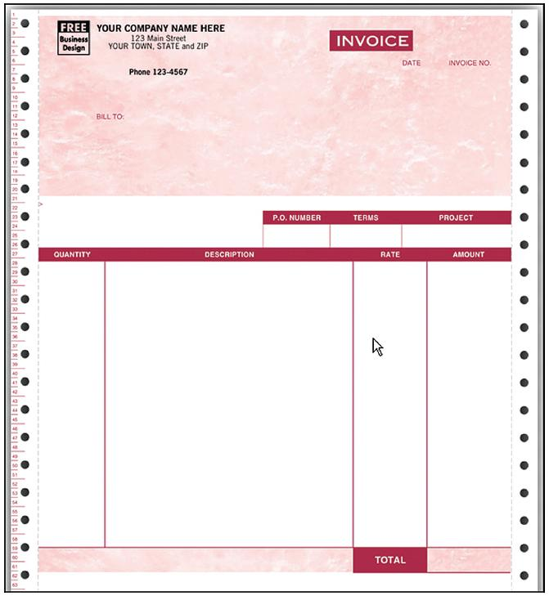
Analyzing Procedures and Other Documents (Cont.)
FIGURE
An example of a business form

Slide 46
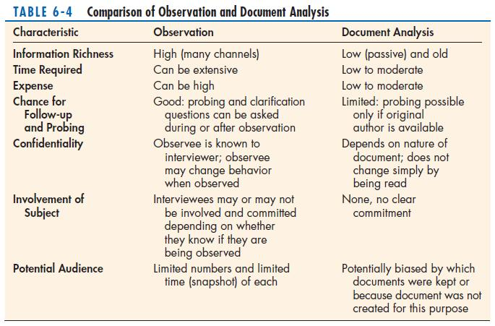
Observation Vs Document Analysis

Slide 47
2- Contemporary Methods for Determining System Requirements
Joint Application Design (JAD)
Brings together key users, managers, and systems analysts
Purpose: collect system requirements simultaneously from key people
Conducted off-site
Group Support Systems
Facilitate sharing of ideas and voicing of opinions about system requirements

Slide 48
Contemporary Methods for Determining System Requirements (Cont.)
CASE tools
Used to analyze existing systems
Help discover requirements to meet changing business conditions
System prototypes
Iterative development process
primary working version of system
Refine understanding of system requirements in concrete terms

Slide 49
2.1- Joint Application Design (JAD)
Intensive group-oriented requirements determination technique
Team members meet in isolation for an extended period of time
Highly focused
Resource intensive
Started by IBM in 1970s

Slide 50
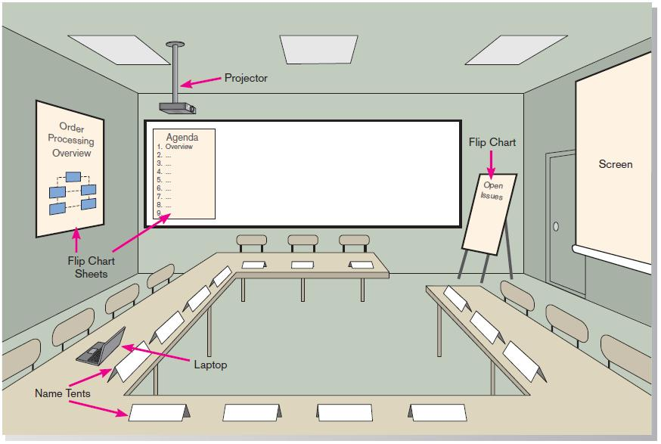
JAD (Cont.)
FIGURE 6-6 Illustration of the typical room layout for a JAD
Source: Based on Wood and Silver, 1995

Slide 51
JAD (Cont.)
JAD Participants:
Session Leader: facilitates group process
Users: active, speaking participants
Managers: active, speaking participants
Sponsor: high-level champion, limited participation
Systems Analysts: should mostly listen
Scribe: record session activities (copier)
IS Staff: should mostly listen

Slide 52
JAD (Cont.)
End Result
Documentation detailing existing system
Features of proposed system

Slide 53
2.2- CASE Tools During JAD
Enables analysts to enter system models directly into CASE during the JAD session
Screen designs and prototyping can be done during JAD and shown to users

Slide 54
2.3- Using Prototyping During Requirements Determination
Quickly converts requirements to working version of system
Once the user sees requirements converted to system, will ask for modifications or will generate additional requests

Slide 55
Using Prototyping During Requirements Determination (Cont.)
Most useful when:
User requests are not clear.
Few users are involved in the system.
Designs are complex and require concrete form.
There is a history of communication problems between analysts and users.
Tools are readily available to build prototype.

Slide 56
Using Prototyping During Requirements Determination (Cont.)
Drawbacks
Tendency to avoid formal documentation
Difficult to adapt to more general user audience
Systems Development Life Cycle (SDLC) checks are often bypassed

Slide 57
3- Radical Methods for Determining System Requirements
Business Process Reengineering (BPR):
search for and implementation of radical change in business processes to achieve breakthrough improvements in products and services

Slide 58
Radical Methods for Determining System Requirements (Cont.)
Goals
Reorganize complete flow of data in major sections of an organization.
Eliminate unnecessary steps.
Combine steps.
Become more responsive to future change.

Slide 59
Identifying Processes to Reengineer
Key business processes
Structured, measured set of activities designed to produce specific output for a particular customer or market
Focused on customers and outcome
Same techniques are used as for requirements determination

Slide 60
Disruptive Technologies
Information technologies must be applied to radically improve business processes.
Disruptive technologies are technologies that enable the breaking of long-held business rules that inhibit organizations from making radical business changes.

Slide 61
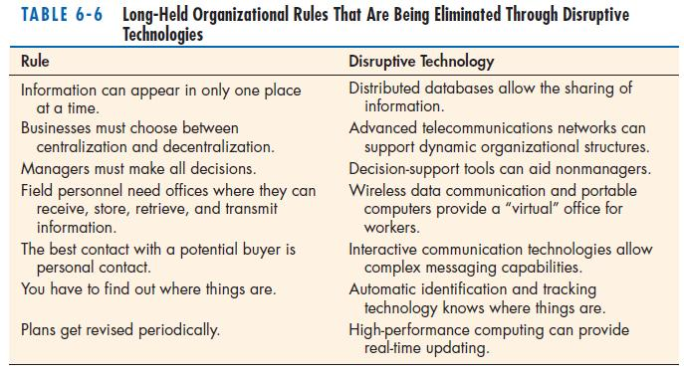
Disruptive Technologies (Cont.)

Slide 62
Requirements Determination using Agile Methodologies
Continual user involvement
Replace traditional SDLC waterfall with iterative analyze – design – code – test cycle
Agile usage-centered design
Focuses on user goals, roles, and tasks
The Planning Game
Based on eXtreme programming
Exploration, steering, commitment

Slide 63
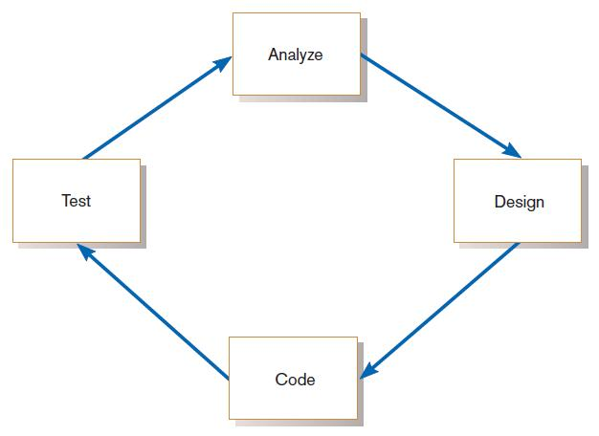
Continual User Involvement
FIGURE 6-11
The iterative analysis–design–code–test cycle

Slide 64
Agile Usage-Centered Design Steps
Gather group of programmers, analysts, users, testers, facilitator.
Document complaints of current system.
Determine important user roles.
Determine, prioritize, and describe tasks for each user role.
Group similar tasks into interaction contexts.
Associate each interaction context with a user interface for the system, and prototype the interaction context.
Step through and modify the prototype.

Slide 65
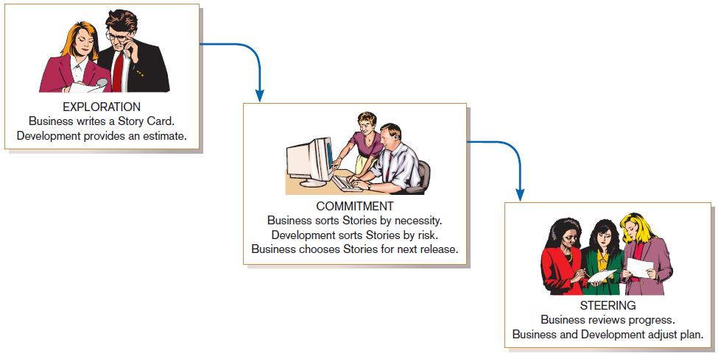
The Planning Game from eXtreme Programming
FIGURE 6-12
eXtreme Programming’s Planning Game

Slide 66
Thanks

